Slide 1





Slide 2


Slide 3


PowerApps Portals – Deep Dive
Victor Dantas
Power Platform Consultant
365 Saturday Ambassador
dantas.ca

Slide 4
Session Topics Overview
How to provision?
PowerApps Portals CMS and Multi-Language Support
CSS Branding / Samples
Site Settings, Site Markers, and Content Snippets
Entity Forms, Entity Views, Entity Permissions, WebForms
Liquid Tags / Web Templates
A few samples
PowerApps Portals DevOps
Q&A
dantas.ca

Slide 5
How to provision a Portal
Prerequisites
CDS Environment;
https://admin.powerapps.com
CDS Database;
PowerApps Portal
https://make.powerapps.com
Community Plan
https://powerapps.microsoft.com/en-us/communityplan/
dantas.ca

Slide 6
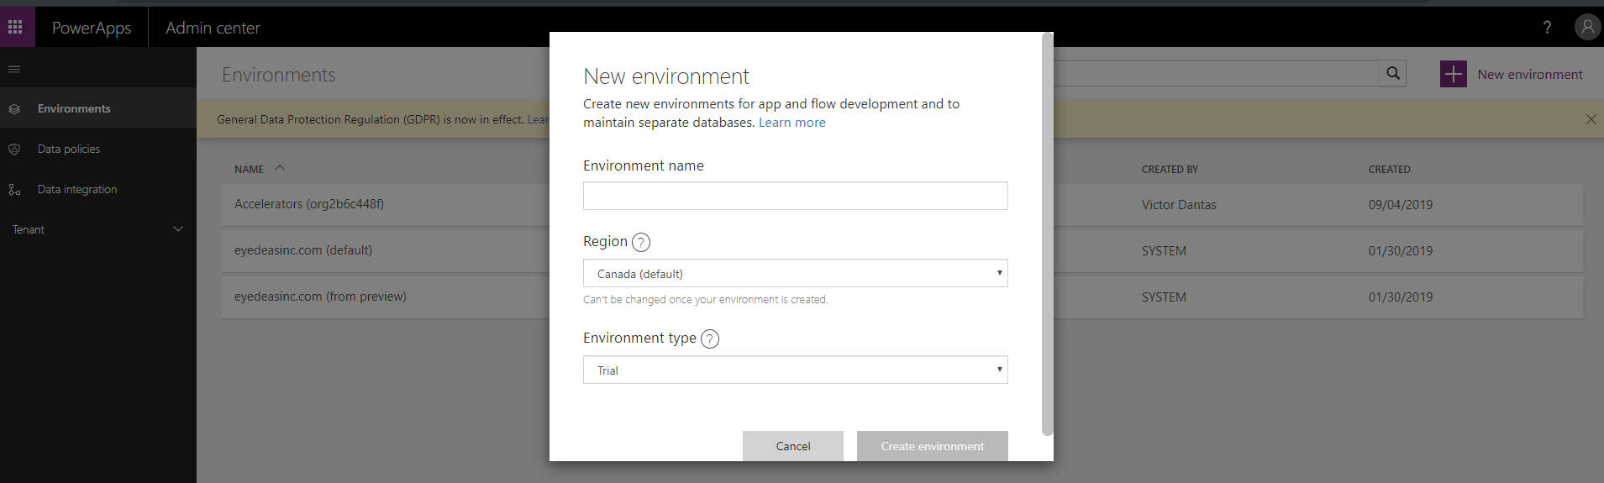
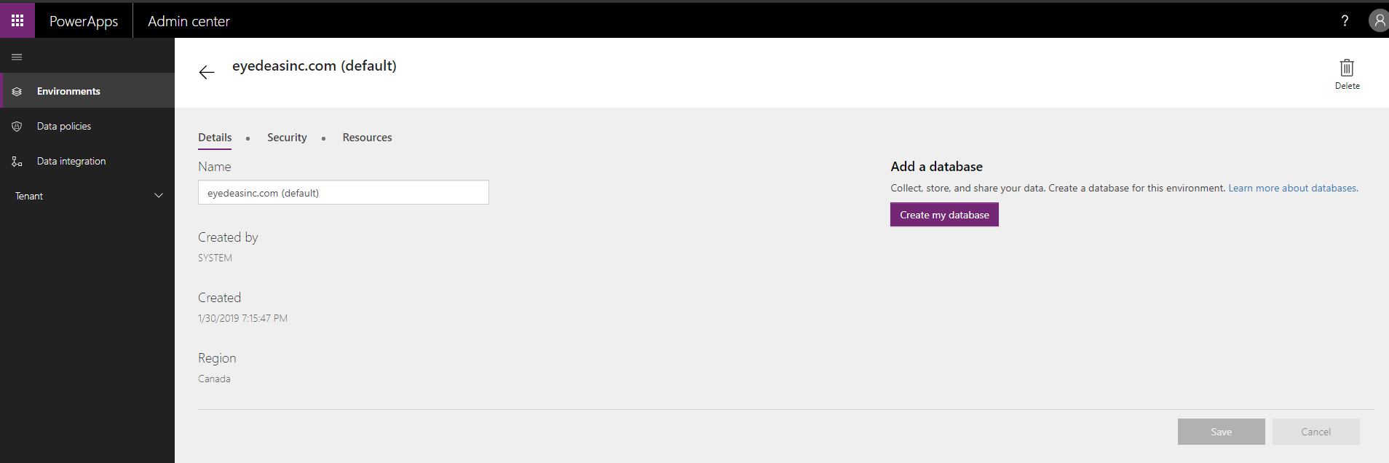
CDS Environment & Database
Notes:
Access portal.office.com Go to Dynamics 365 Admin > Portal Entry
Once Portals is configured, explain the security model.

Slide 7
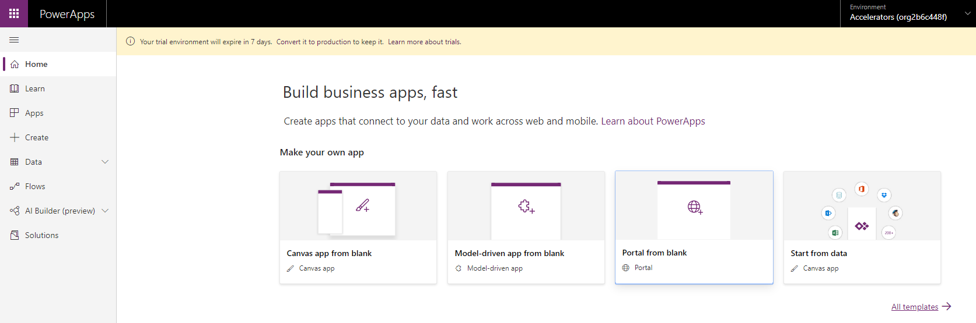
How to provision a Portal
Notes:
Access portal.office.com Go to Dynamics 365 Admin > Portal Entry
Once Portals is configured, explain the security model.

Slide 8
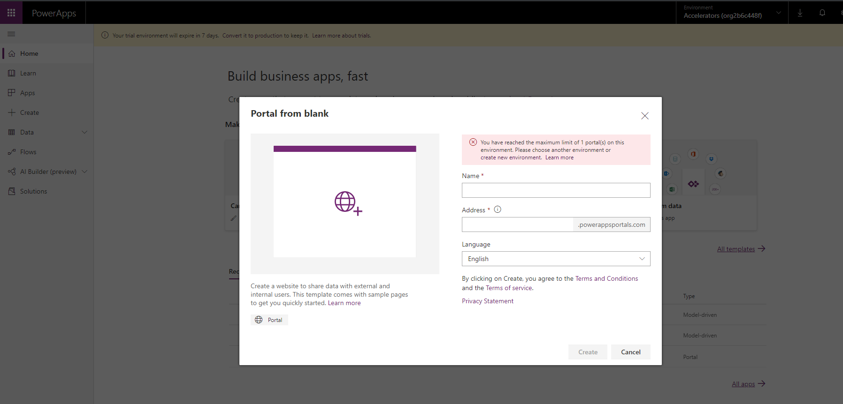
How to provision a Portal
Notes:
Access portal.office.com Go to Dynamics 365 Admin > Portal Entry
Once Portals is configured, explain the security model.

Slide 9
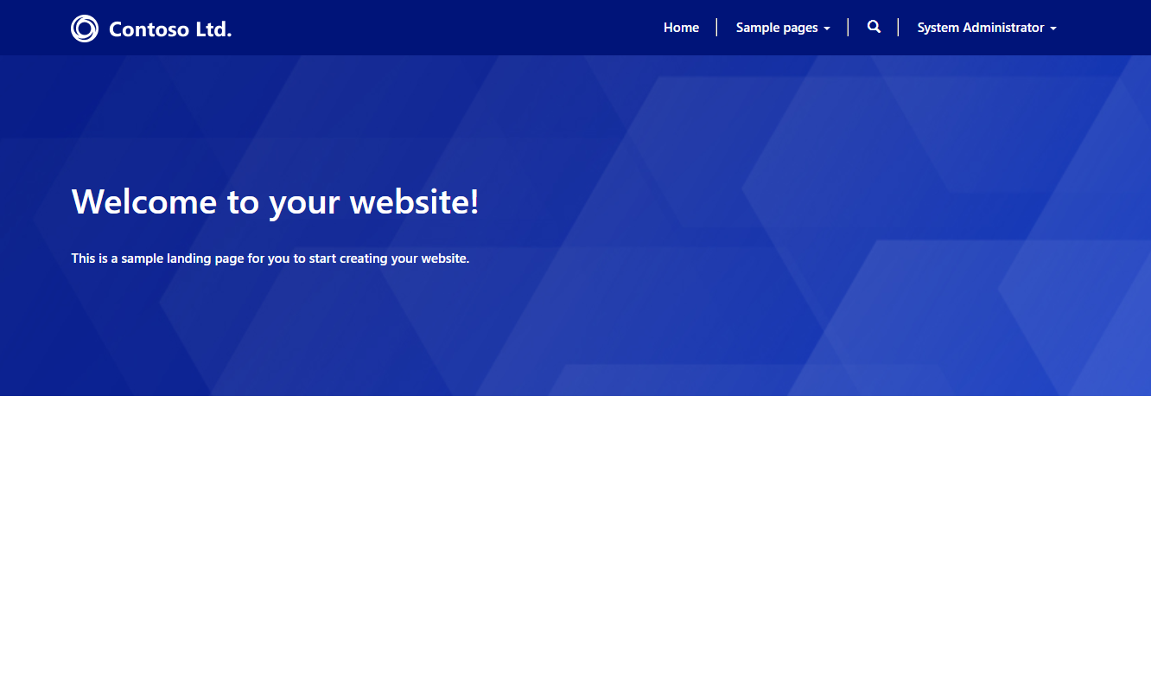
First Glance - CMS and Multi-Language Support
Notes:
Show how to create from Portal Templates.

Slide 10
Portal Branding
Demo

Slide 11
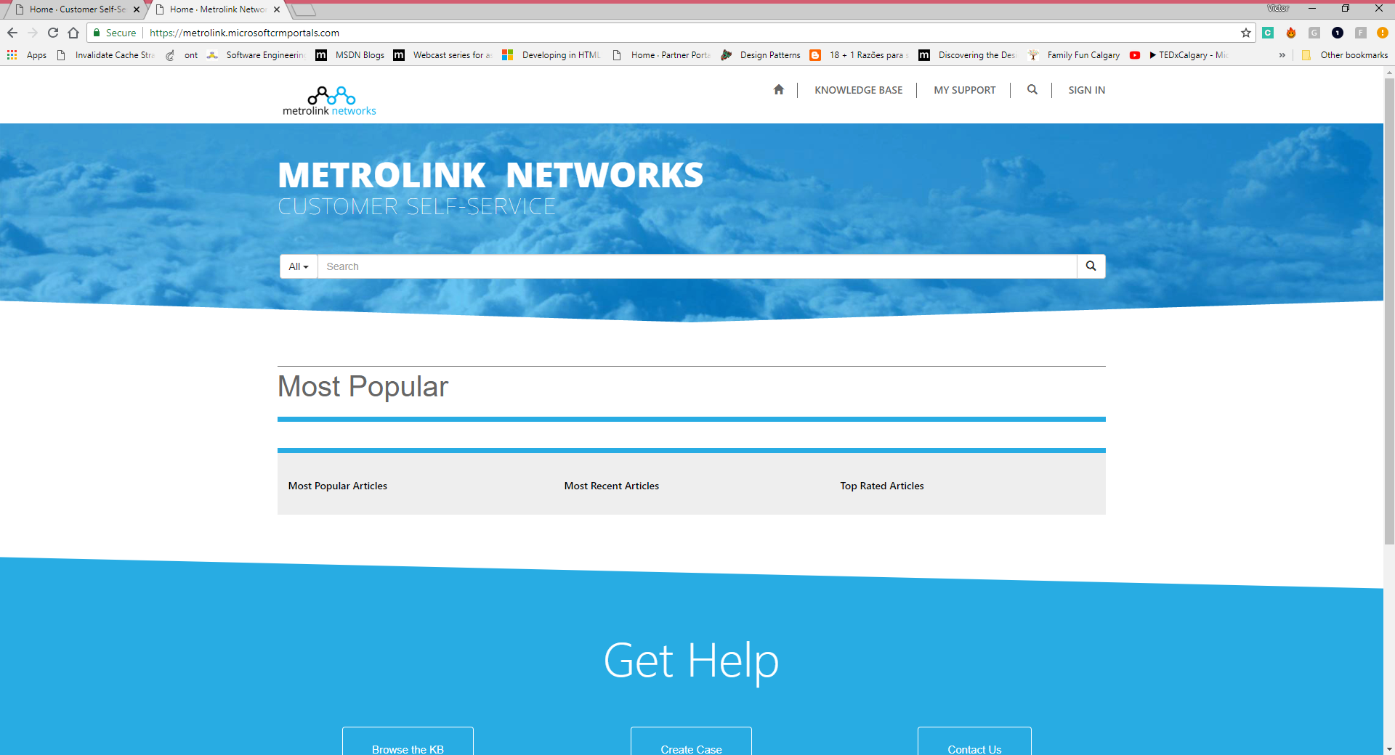
Portal Branding

Slide 12
Portal Components What is going on behind the scenes?
Websites
Web Pages
Site Settings
Web Pages
WebPage Localized Content
Page Template
Content Snippets
Entity Forms,
Entity Views
Page Template
Rewrite (ASP.NET based page ).
Web Templates
Web Template
HTML
Liquid
Web Files

Slide 13
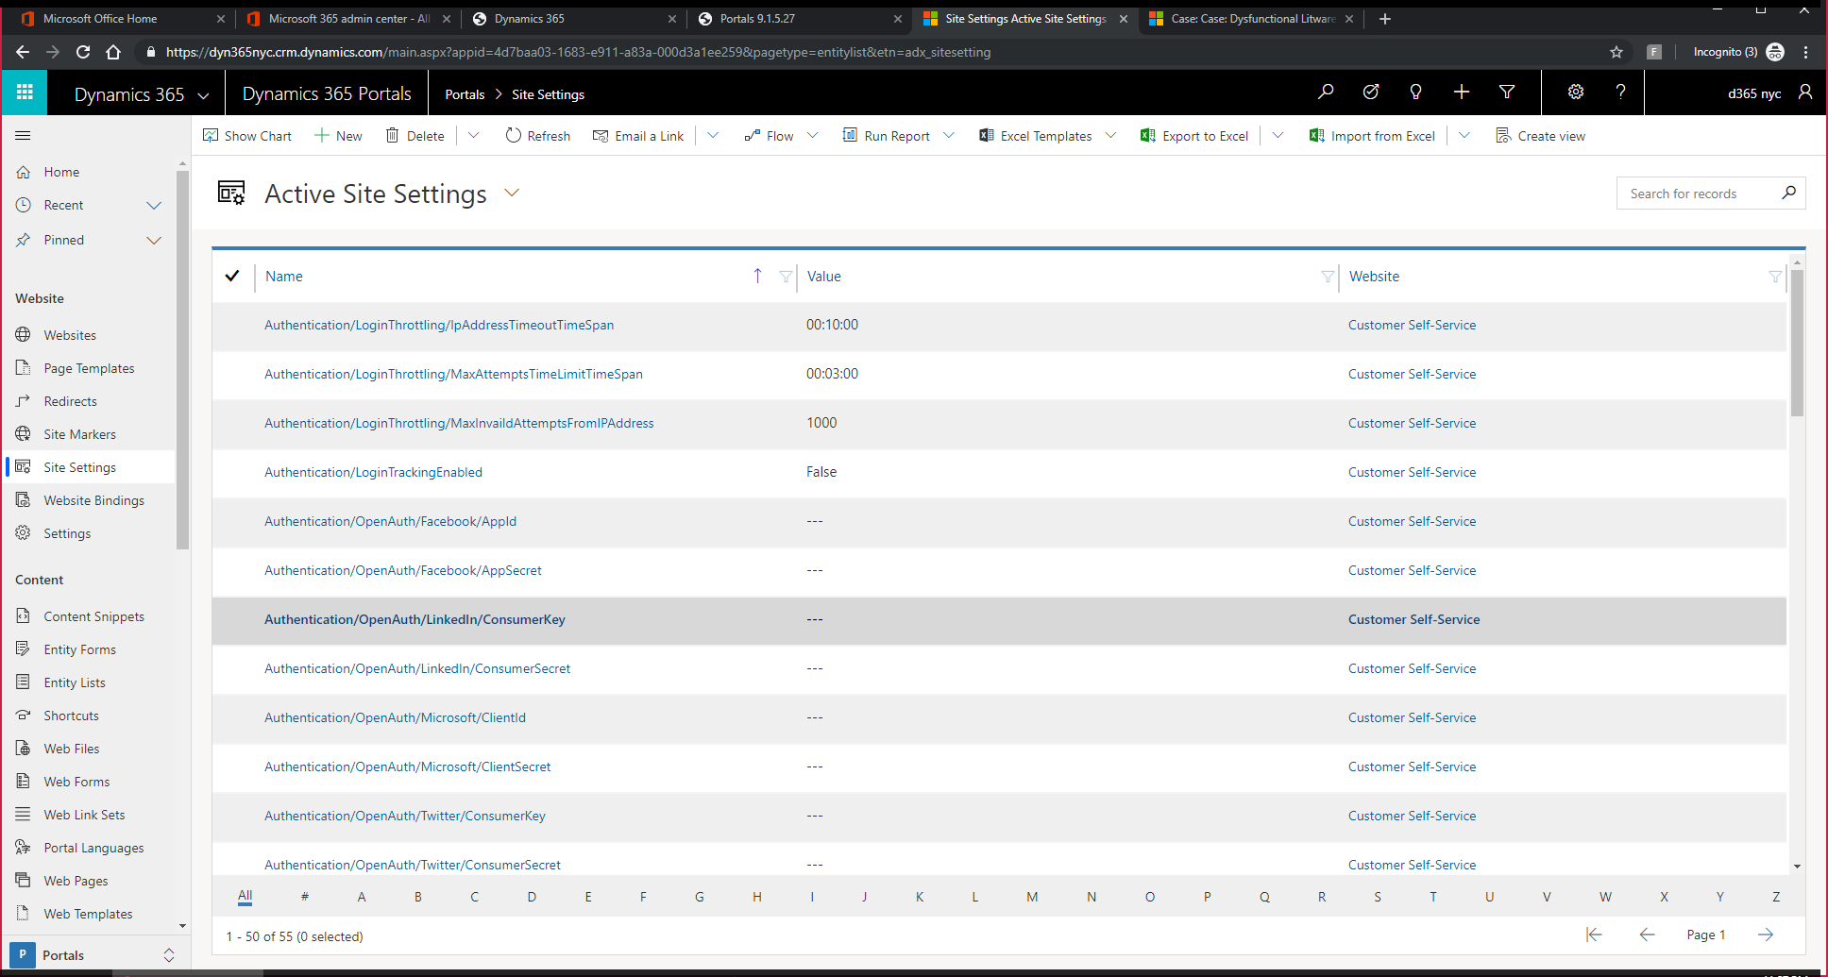
Site Settings, Site Markers and Content Snippets
Notes:
Site Settings: Authentication config (Local, Oauth, Open Connect, B2C), Grid page Size, Search Index, etc. Site Markers: Define Place holders for page navigation. Content Snippets: Labels, and localized display components.

Slide 14
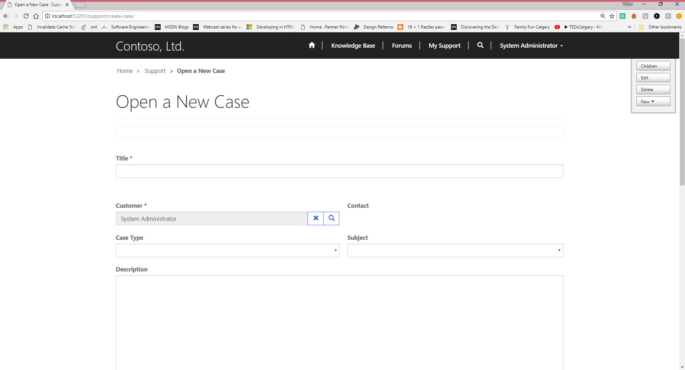
Entity Forms, Entity LIST, Entity Permissions and Web Forms
Notes:
Create

Slide 15
Entity Forms, Entity Views, Entity Permissions and Web Forms
Entity List Sample
Entity Form Sample
Entity Permission
Global, Contact, Account, and Parent
Notes:
Entity List: https://dyn365nyc.microsoftcrmportals.com/support/
Entity List ++: https://dyn365nyc.microsoftcrmportals.com/support-bling-added/
Entity Form: https://dyn365nyc.microsoftcrmportals.com/contact-management-sample/
Entity Forms ++: https://dyn365nyc.microsoftcrmportals.com/profile/company-profile/

Slide 16
Entity FORMs
Demo
Notes:
{% chart id:EE3C733D-5693-DE11-97D4-00155DA3B01E %}
https://dyn365nyc.microsoftcrmportals.com/power-bi-sample/
https://dyn365nyc.microsoftcrmportals.com/liquid-sample/

Slide 17
Entity LIST
Demo
Notes:
{% chart id:EE3C733D-5693-DE11-97D4-00155DA3B01E %}
https://dyn365nyc.microsoftcrmportals.com/power-bi-sample/
https://dyn365nyc.microsoftcrmportals.com/liquid-sample/

Slide 18
Entity mETADATA
Demo
Notes:
{% chart id:EE3C733D-5693-DE11-97D4-00155DA3B01E %}
https://dyn365nyc.microsoftcrmportals.com/power-bi-sample/
https://dyn365nyc.microsoftcrmportals.com/liquid-sample/

Slide 19
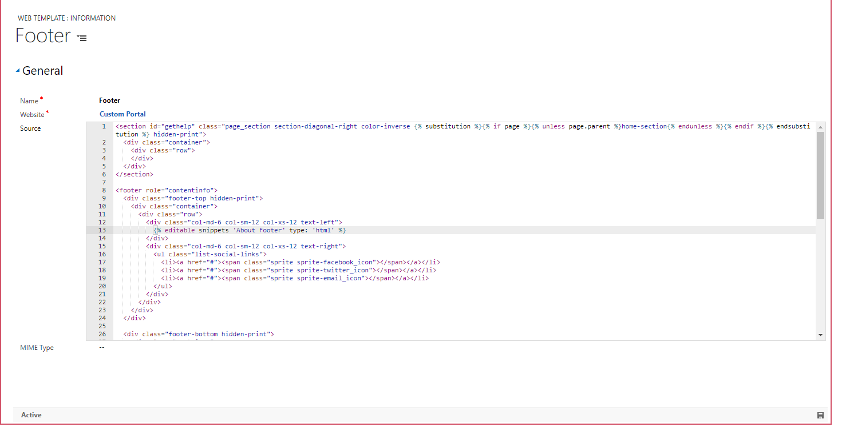
Liquid / Web Templates
Notes:
https://deepdive.powerappsportals.com/contact-json-service/

Slide 20
Liquid
Template programming language created by Shopify;
https://help.shopify.com/en/themes/liquid
Liquid .NET
https://github.com/mikebridge/Liquid.NET
PowerApps Portals Liquid Objects
https://docs.microsoft.com/en-us/dynamics365/customer-engagement/portals/liquid-objects
Main objects
page
entities : Allows access to any CDS entity by ID
now: Renders current UTC time
params : Shortcut to request.params
settings : Allows access to Portal site settings
snippets: Allos access to Portal snippets
user : Refers to the portal user record and its data attributes
Other dynamic tags : chart, powerbi* (requires portal configuration), editable, entityform, entitylist, entityview,
https://docs.microsoft.com/en-us/dynamics365/customer-engagement/portals/dynamics-entity-tags
Notes:
https://dyn365nyc.microsoftcrmportals.com/liquid-sample/

Slide 21
Liquid Sample
Rendering User and CE Chart
Notes:
{% chart id:EE3C733D-5693-DE11-97D4-00155DA3B01E %}
https://dyn365nyc.microsoftcrmportals.com/power-bi-sample/
https://dyn365nyc.microsoftcrmportals.com/liquid-sample/

Slide 22
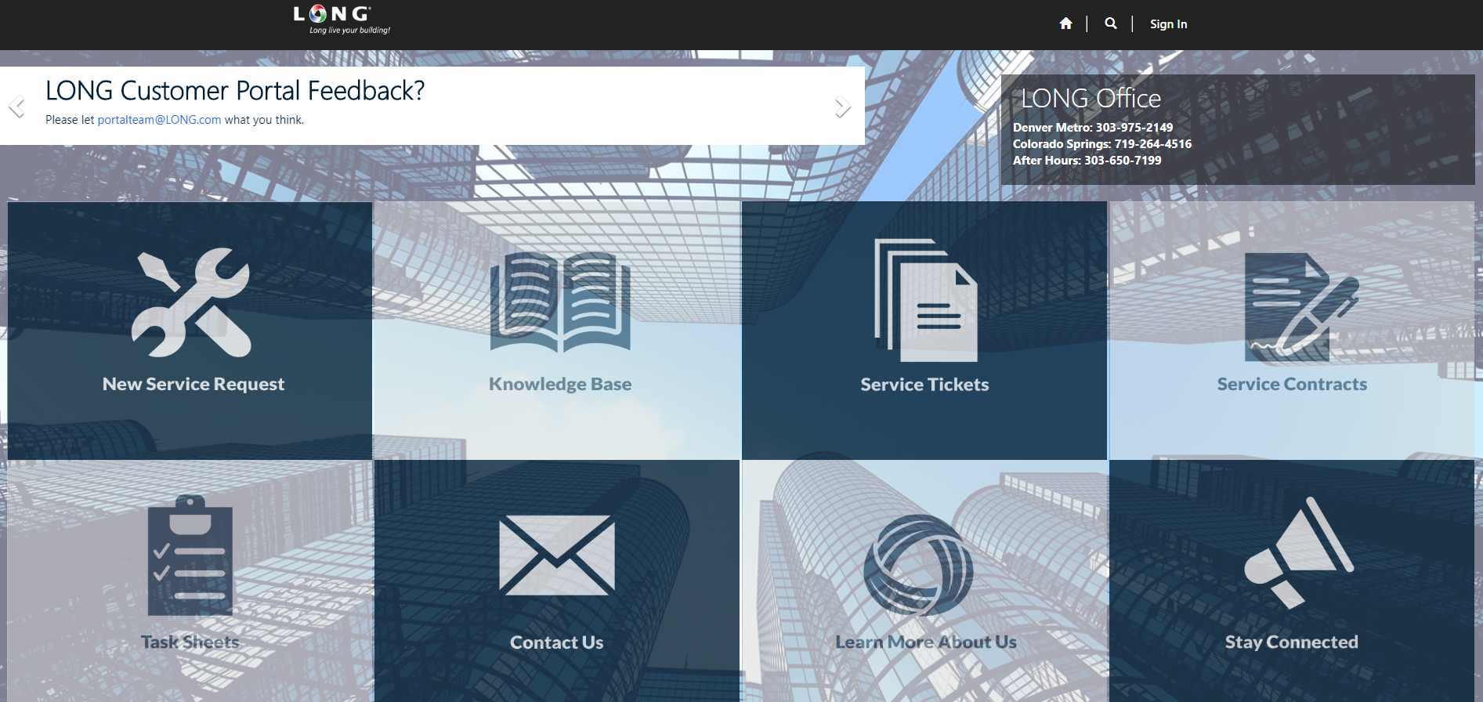
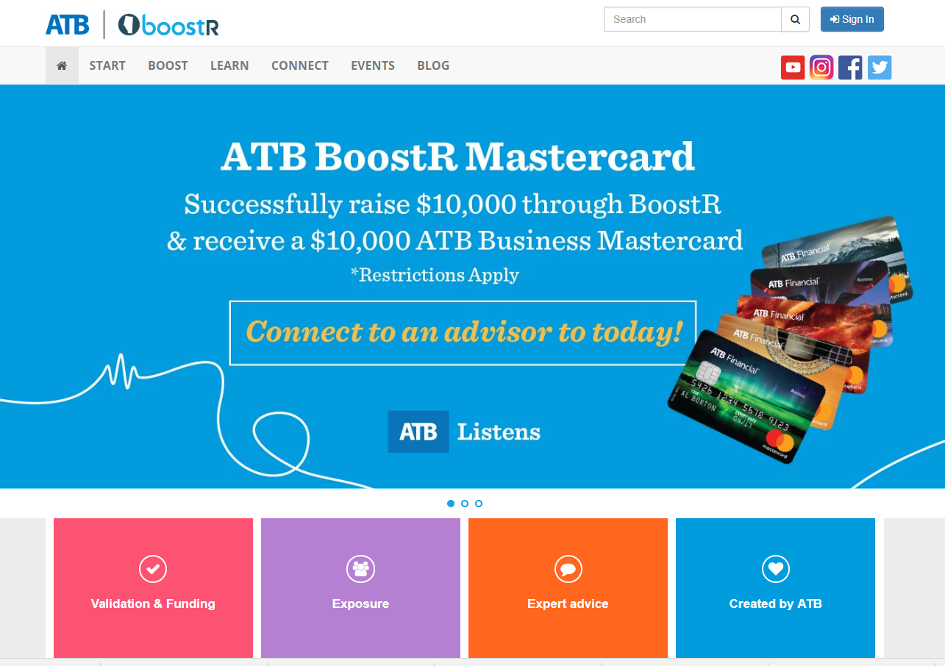
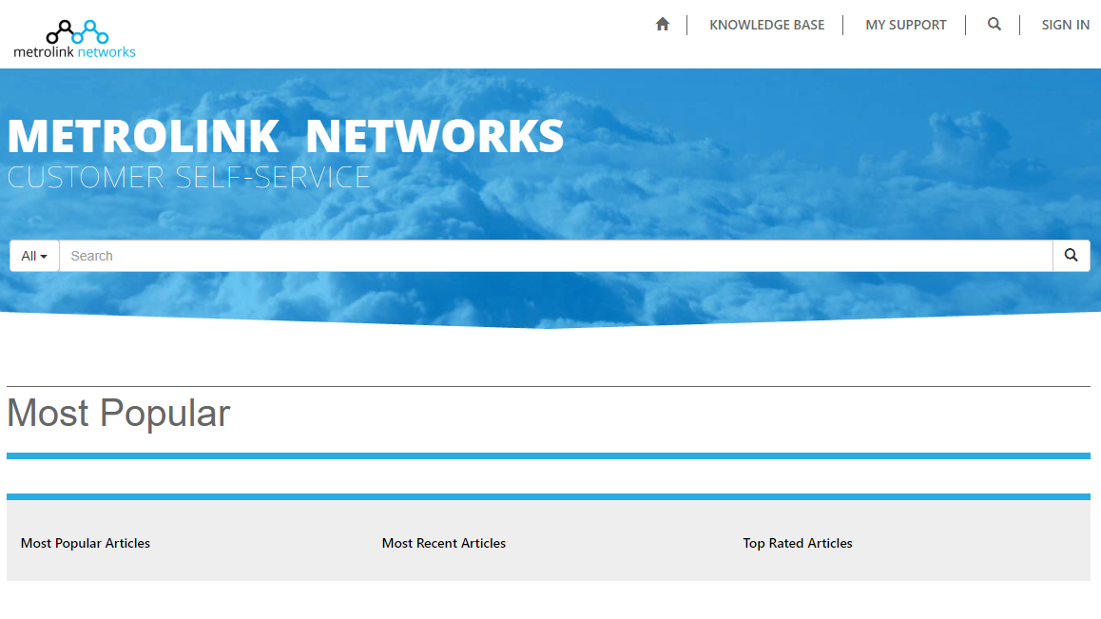
Cool Portal Samples

Slide 23
POWERAPPS Portals DevOps
TFS/Git for Source control
Custom Kingsway soft SSIS packages to move/copy Portal config data;
James Novak – PortalRecordsMover tool
Console: https://github.com/jamesnovak/PortalRecordsMoverConsole
XrmToolBox: https://www.xrmtoolbox.com/plugins/MscrmTools.PortalRecordsMover/

Slide 24
PowerApps Portals Other open-source projects
PowerApps Portals – D365 Webapi Wrappers
https://github.com/dantasvictor/PowerAppsPortalsWebAPI
XrmPortalJS
https://github.com/dynamicscode/XrmPortalJS
PowerApps Portals Accelerators
PowerApps Portals AzureDevOps CI/CD task – Eugene van Staden
Notes:
https://github.com/dantasvictor/PowerAppsPortalsWebAPI
https://github.com/dynamicscode/XrmPortalJS

Slide 25
PowerApps Portals DevOps – Common Scenario
Create your script using James Novak PortalRecordsMoverConsole;
Save it to an Xml export file;
Store the it in Source Control;
Upon commit execute another script using James Novak PortalRecordsMoverConsole to push the changes to another environment; (CI);

Slide 26
Follow the stars (and me)
James Novak : https://futurezconsulting.com/tag/portals/
Colin Vermander : https://colinvermander.com/tag/crm-portals/
Nicholas Hayduk : https://www.engineeredcode.com/blog
Nick Doelman : http://readyxrm.blog
Raz Dynamics and 365 Community: https://www.365portal.org/
Victor Dantas: https://community.dynamics.com/crm/b/powerapps-4-devs

Slide 27
Q&A
Victor Dantas
Power Platform Consultant
365 Saturday Ambassador
dantas.ca

Slide 28
The Power of Community
“As iron sharpens iron, so a friend sharpens another”
dantas.ca

Slide 29
Thanks!
Please expand notes window at bottom of slide and read. Then Delete this text box.
Email: victor@dynamics.community
dantas.ca

Slide 30
WHAT’S NEXT?
Webinars:
No Xrm Coder left behind Webinar – Dec 5th 2019
Portals - Mastering Webtemplates Webinar – Jan 8th, 2020
Conferences:
Dynamics Power Conference Tel Aviv, Israel – Nov 21st, 2019
Dynamics Power Conference Paris, France – Nov 22nd, 2019
Dynamics Power Conference Dubai, UAE – Feb 29th, 2020
365 Saturday NYC, NY – March 13th, 2020 – TBC*
365 Saturday Seattle, MVP Summit Special – March 21st, 2020
365 Saturday Los Angeles – April 18th, 2020 – TBC*
365 Saturday Calgary – May 2nd, 2020
365 Saturday Caribbean Edition – Florida / Puerto Rico – May 16th, 2020
365 Saturday Quebec City – June 20th, 2020
Please expand notes window at bottom of slide and read. Then Delete this text box.
dantas.ca
365portal.org
Notes:
https://github.com/dantasvictor/365Saturday/tree/master/Webinars/Portals%20Deep%20Dive

